Slide 1
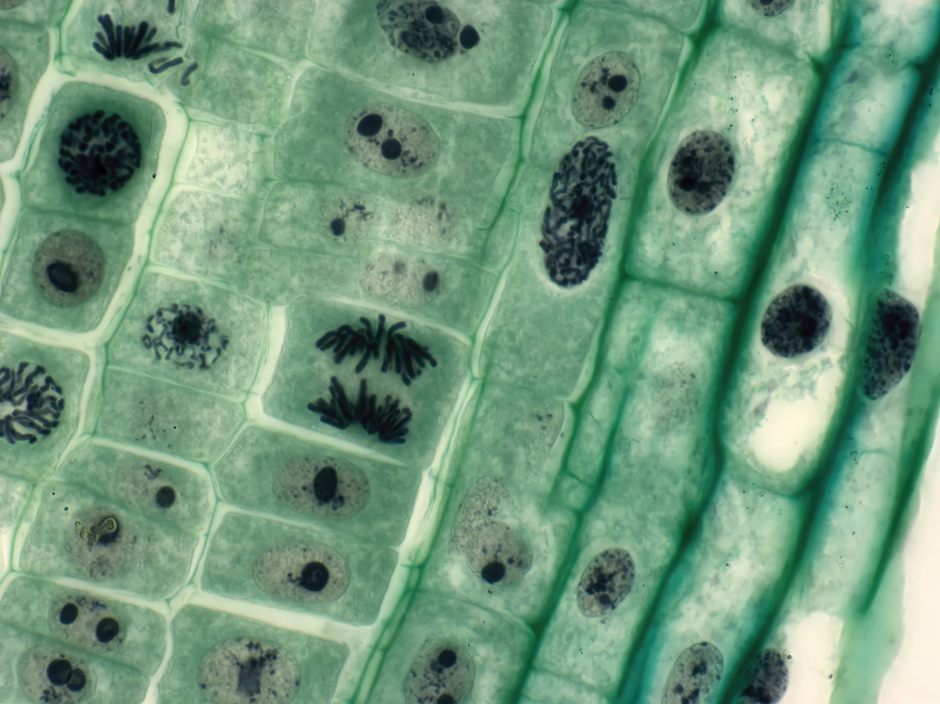

Wardiere Inc.
Introduction to
Biotechnology
Exploring Science and Innovation That Transform Life and Industry
Presented by
Date
Avery Davis
03 April, 2026

Slide 2

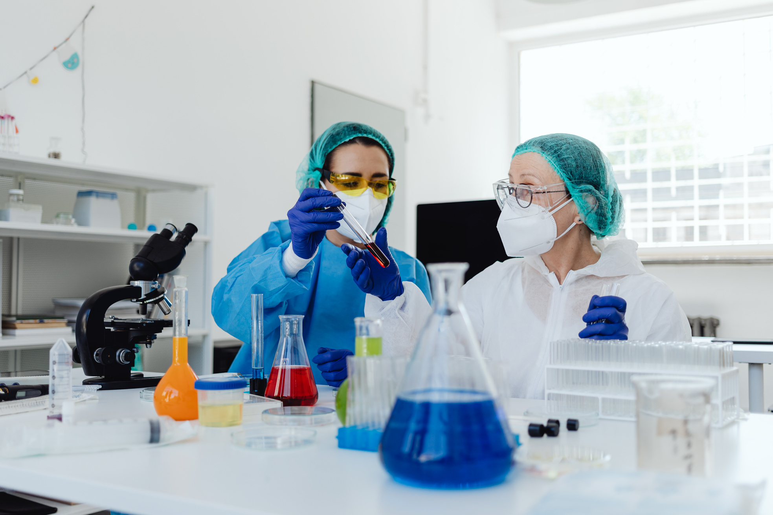
Wardiere Inc.
UNDERSTANDING
The Core Concept of Biotechnology
Biotechnology refers to the use of living organisms, cells, and biological systems to create products and technologies that improve human life. This interdisciplinary field integrates biology, chemistry, genetics, and engineering to develop innovative solutions across multiple industries.
From developing vaccines to improving crop yields, biotechnology plays a crucial role in addressing global challenges and advancing scientific progress.

Slide 3


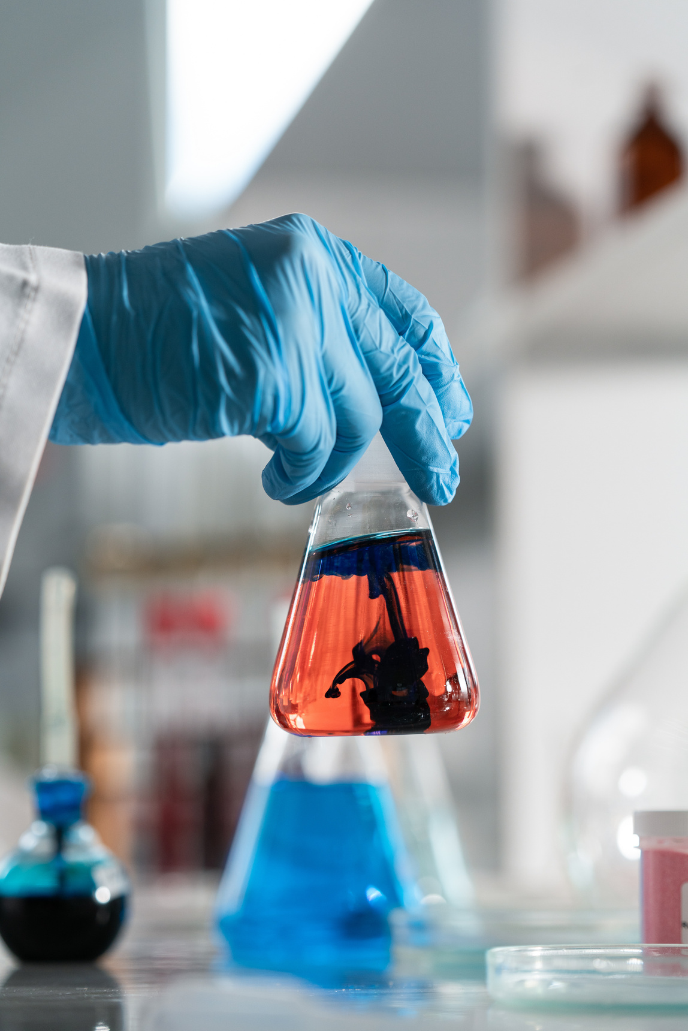
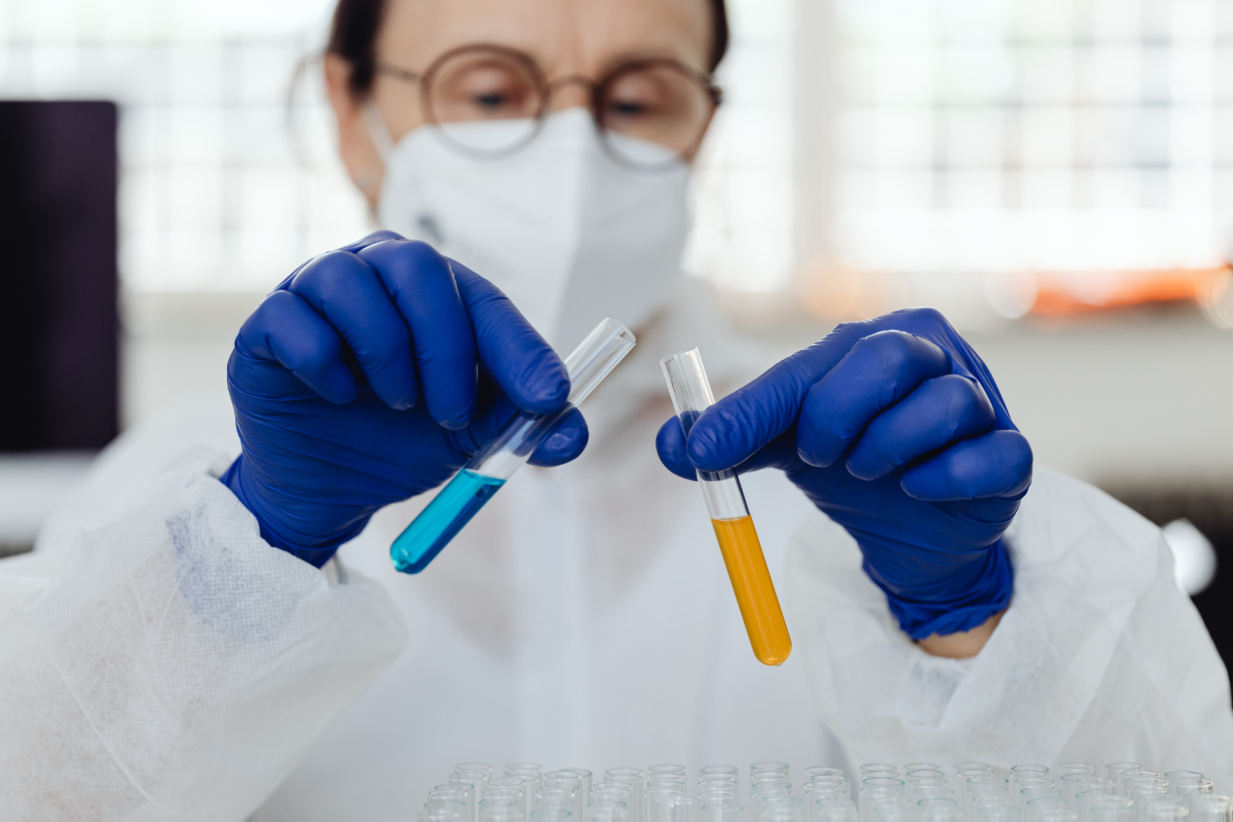
Biotechnology Innovation
Wardiere Inc.
Breakthrough Technologies Transforming the Future
Biotechnology innovation continues to transform industries by introducing advanced technologies that improve healthcare, agriculture, and environmental sustainability. These breakthroughs enable scientists and researchers to develop more efficient solutions, enhance productivity, and address complex global challenges.

Slide 4
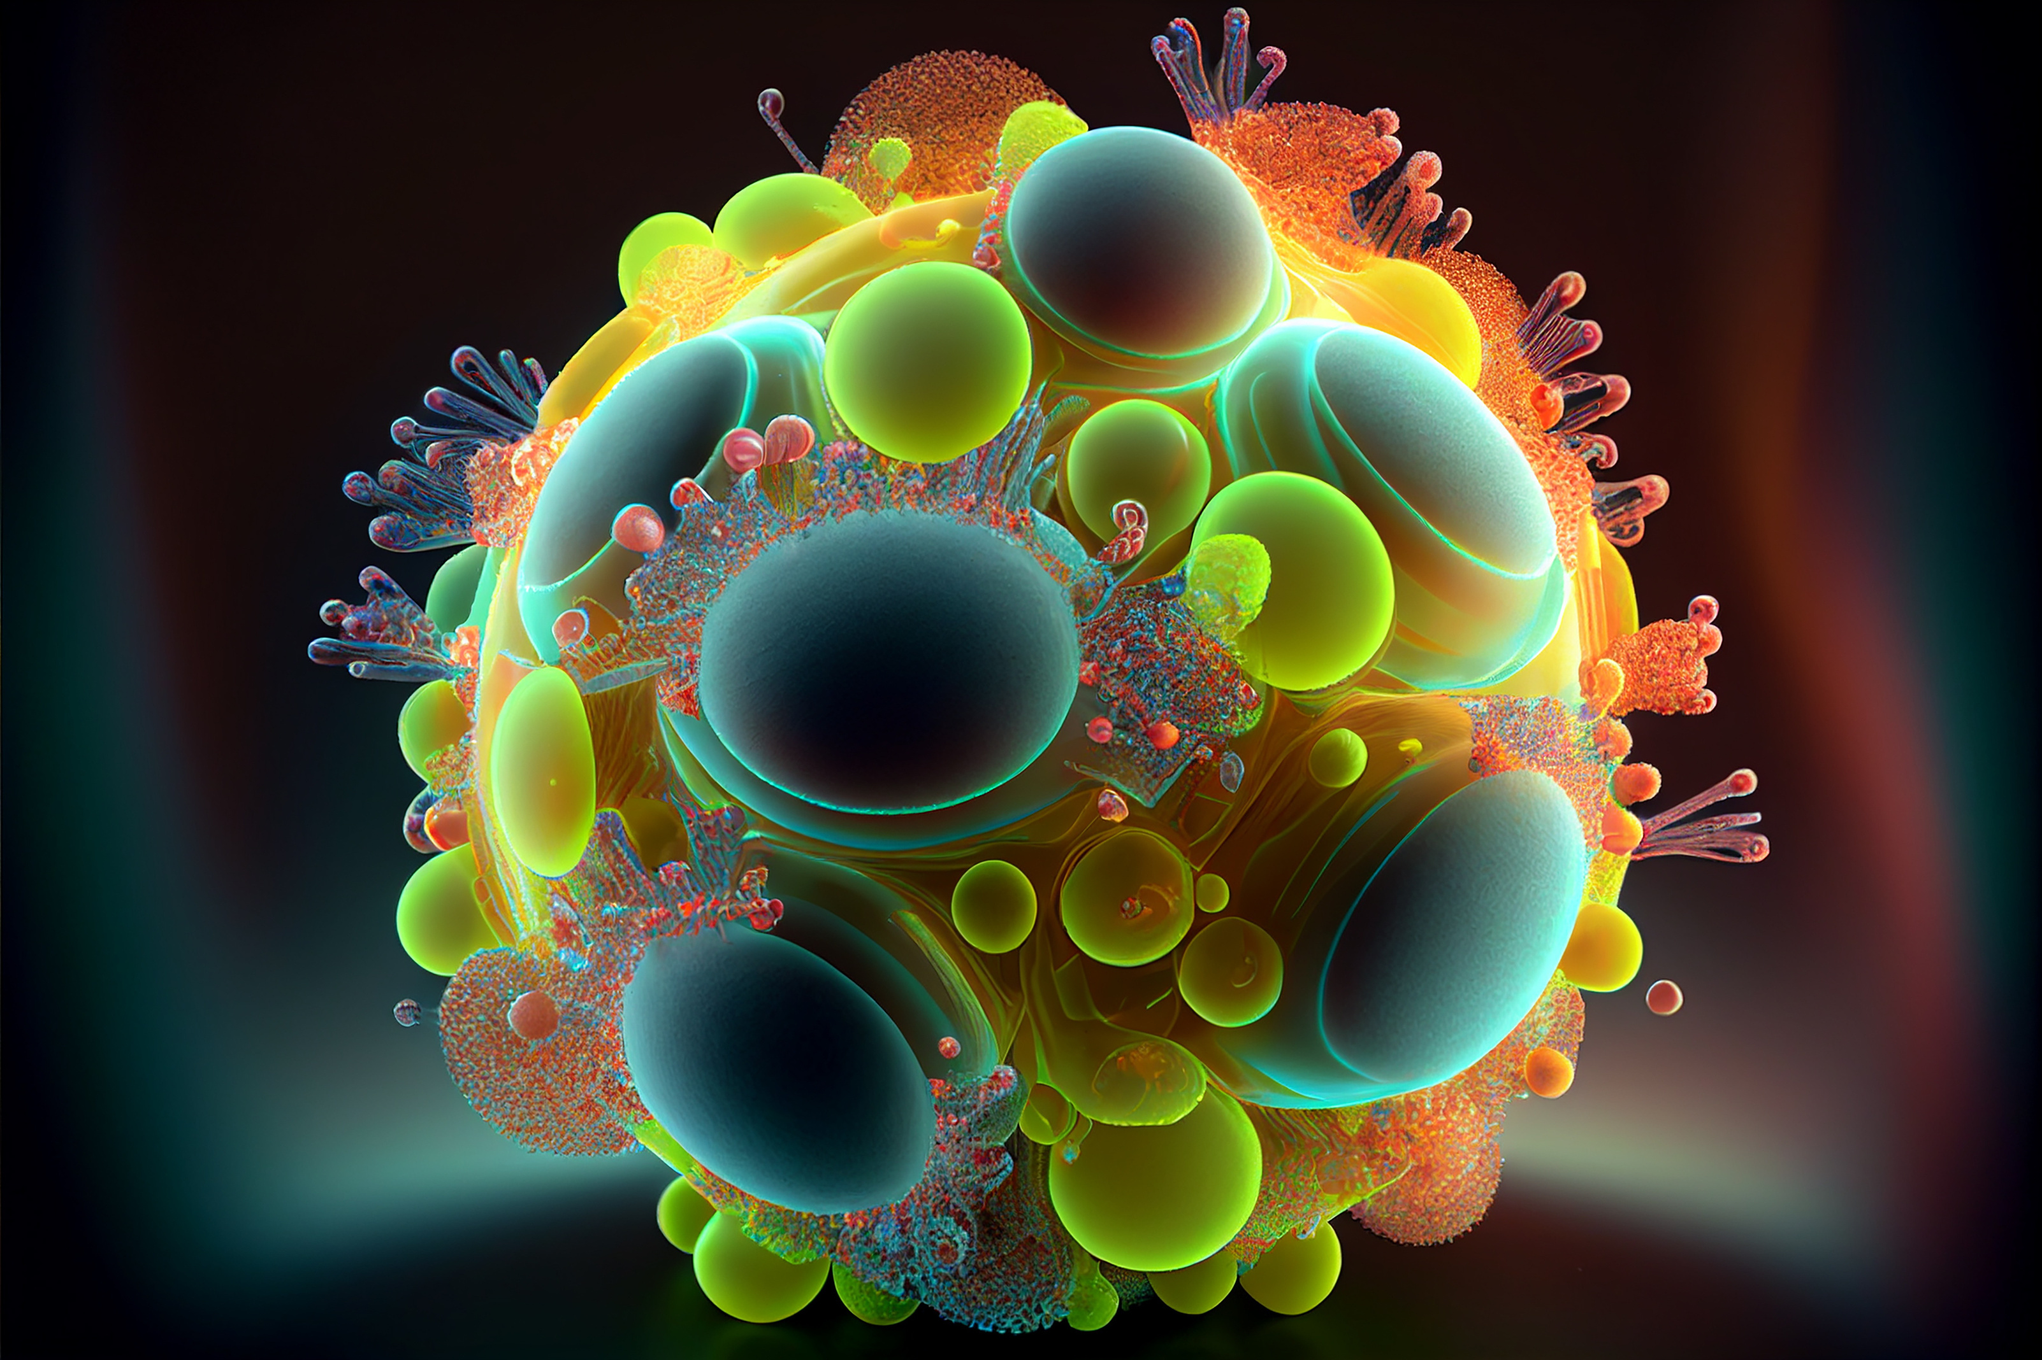
Wardiere Inc.
Different Fields of Biotechnology Applications
1
2
3
4
Biotechnology is divided into several categories based on application areas. Each type focuses on solving specific challenges using biological systems and technological innovation.
Medical Biotechnology
Agricultural Biotechnology
Industrial Biotechnology
Enviromental Biotechnology
Focuses on developing vaccines, drugs, and therapies to improve healthcare outcomes.
Enhances crop productivity, pest resistance, and food quality using biological techniques.
Uses microorganisms and enzymes for sustainable industrial production.
Applies biological processes to manage waste and protect ecosystems.
These classifications help organize research and development across industries.

Slide 5

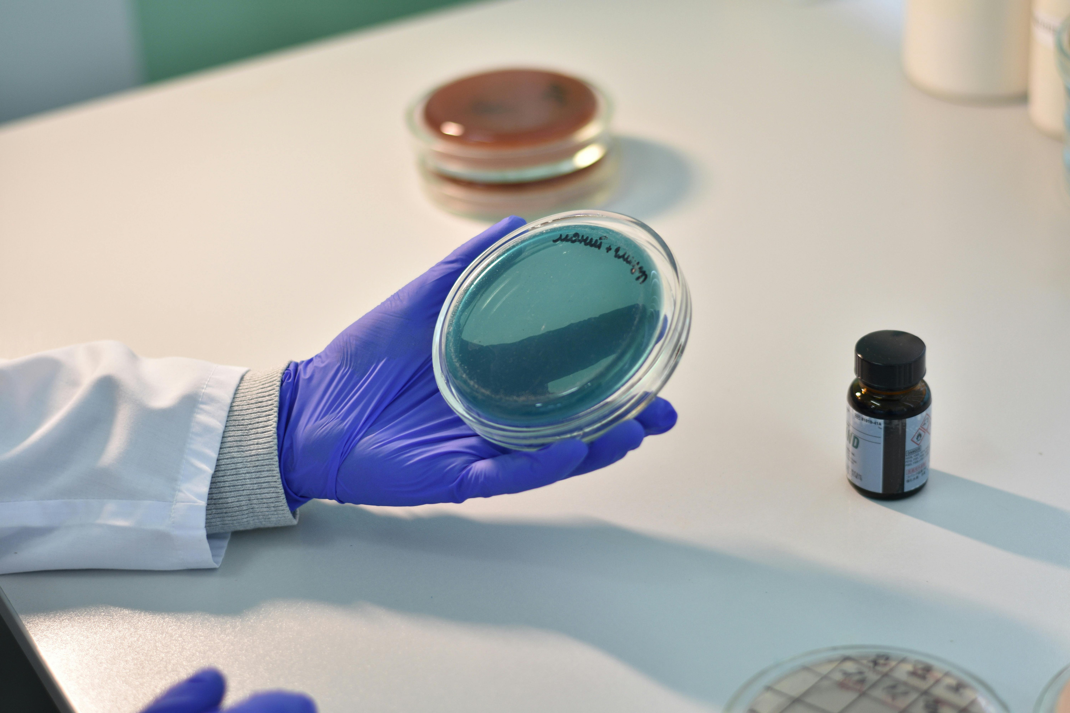
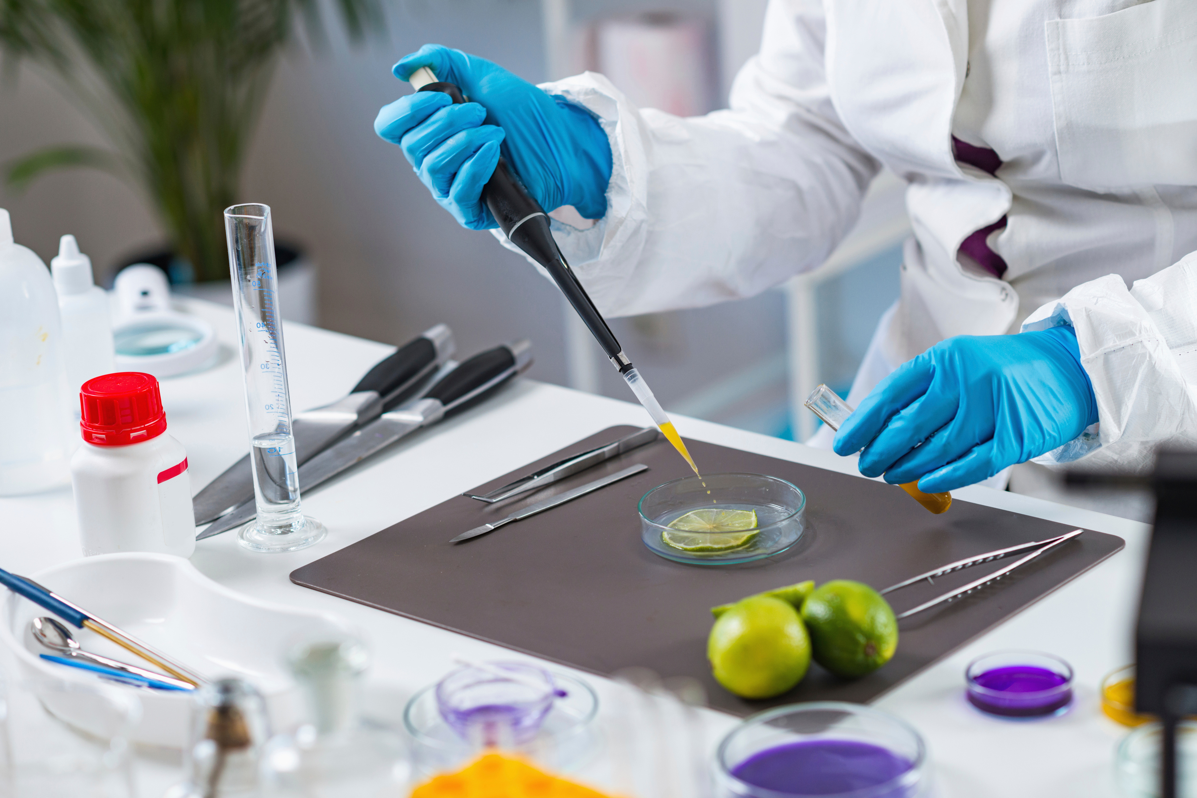
Wardiere Inc.
Benefits of Biotechnology
Positive Impact Across Industries
Biotechnology provides solutions to global challenges by improving healthcare, food production, and sustainability.
1
Enviromental Biotechnology
3
Environmental Protection
2
Food Security
4
Industrial Efficiency

Slide 6
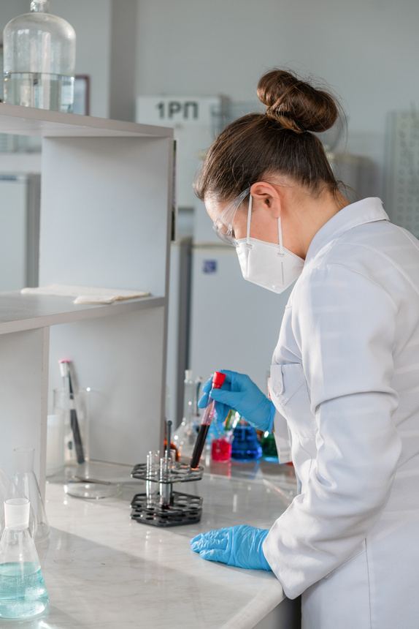
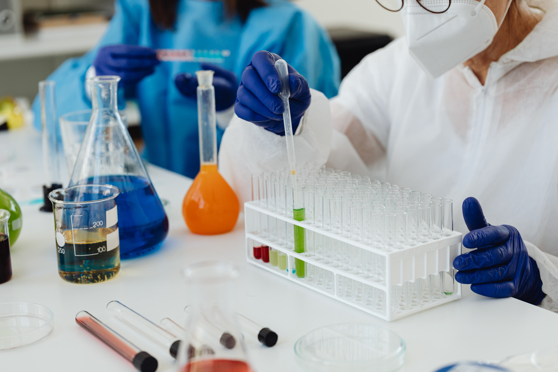
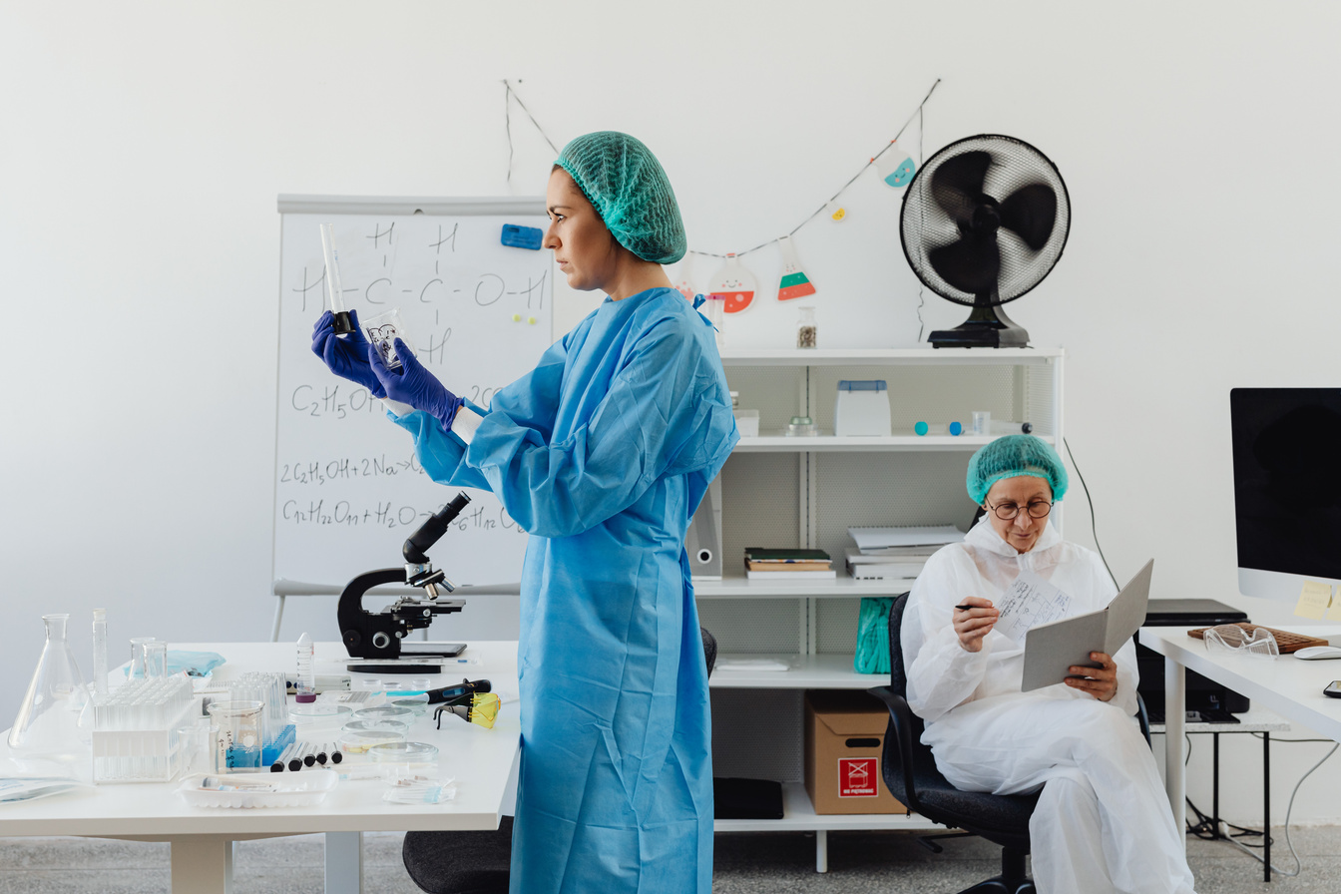

Biotechnology Challenges
Addressing Ethical and Technical Considerations
1
Ethical Concern
2
Research Costs
Biotechnology developments, particularly genetic modification the appropriate boundaries of altering living organisms for human benefit.
Biotechnology research and development require significant financial investment due to advanced laboratory equipment, skilled professionals, etc.
3
Regulatory Requirements
4
Public Awareness
Limited understanding of biotechnology among the general public can lead to misconceptions, highlighting the importance of education.
Biotechnology products must undergo complex approval processes to ensure safety with national and international standards.
Wardiere Inc.

Slide 7
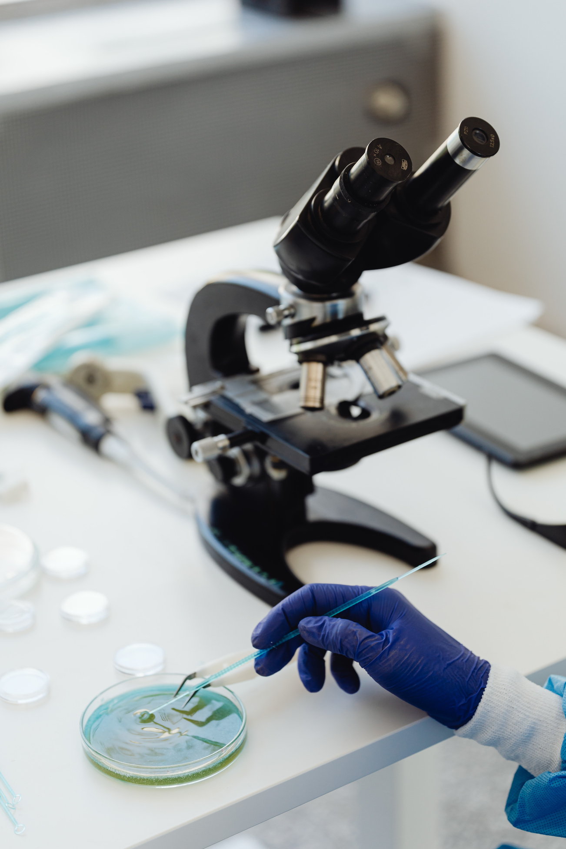
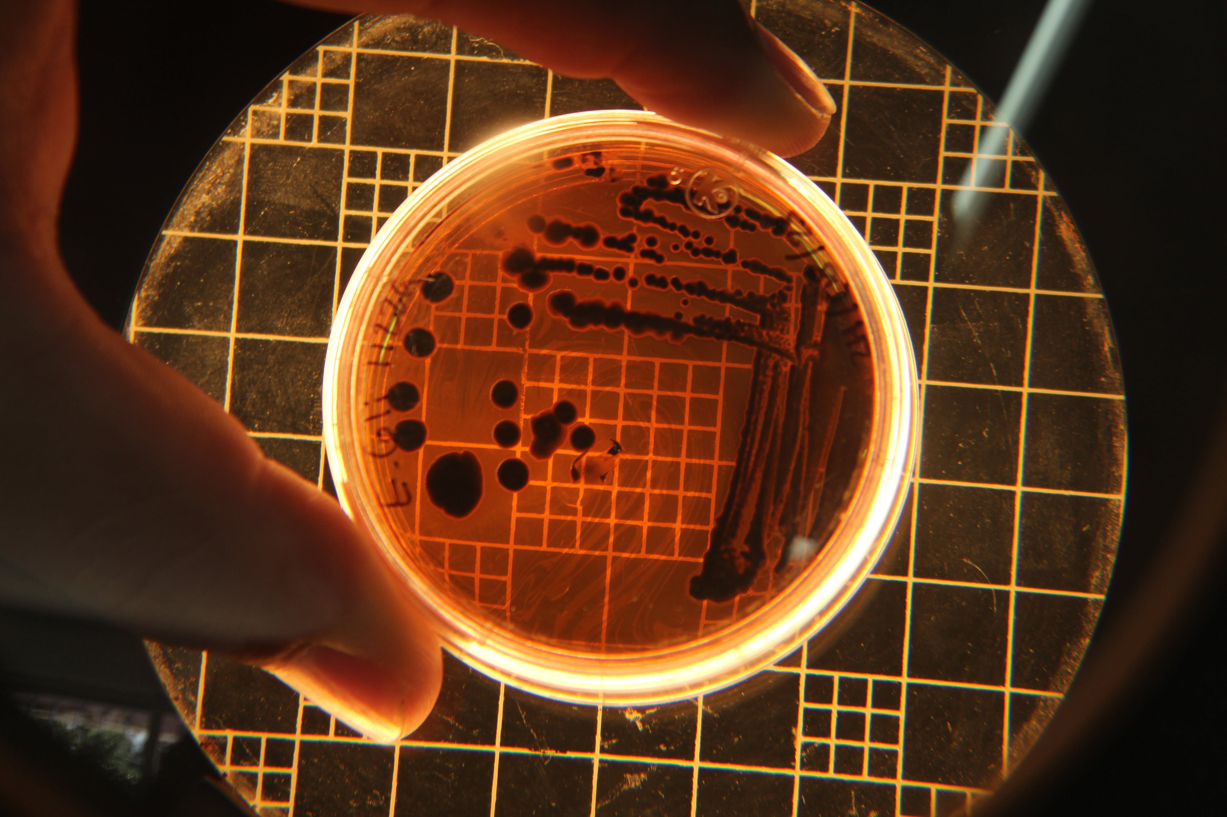
Wardiere Inc.
Future of Biotechnology
Innovation Shaping Tomorrow
The future of biotechnology is expected to drive major advancements across healthcare, agriculture, industry, and environmental sustainability. Emerging technologies such as gene editing, synthetic biology, and artificial intelligence are enabling more precise and efficient biological solutions.
These innovations support the development of personalized medicine, improved crop resilience, and sustainable food alternatives.

Slide 8
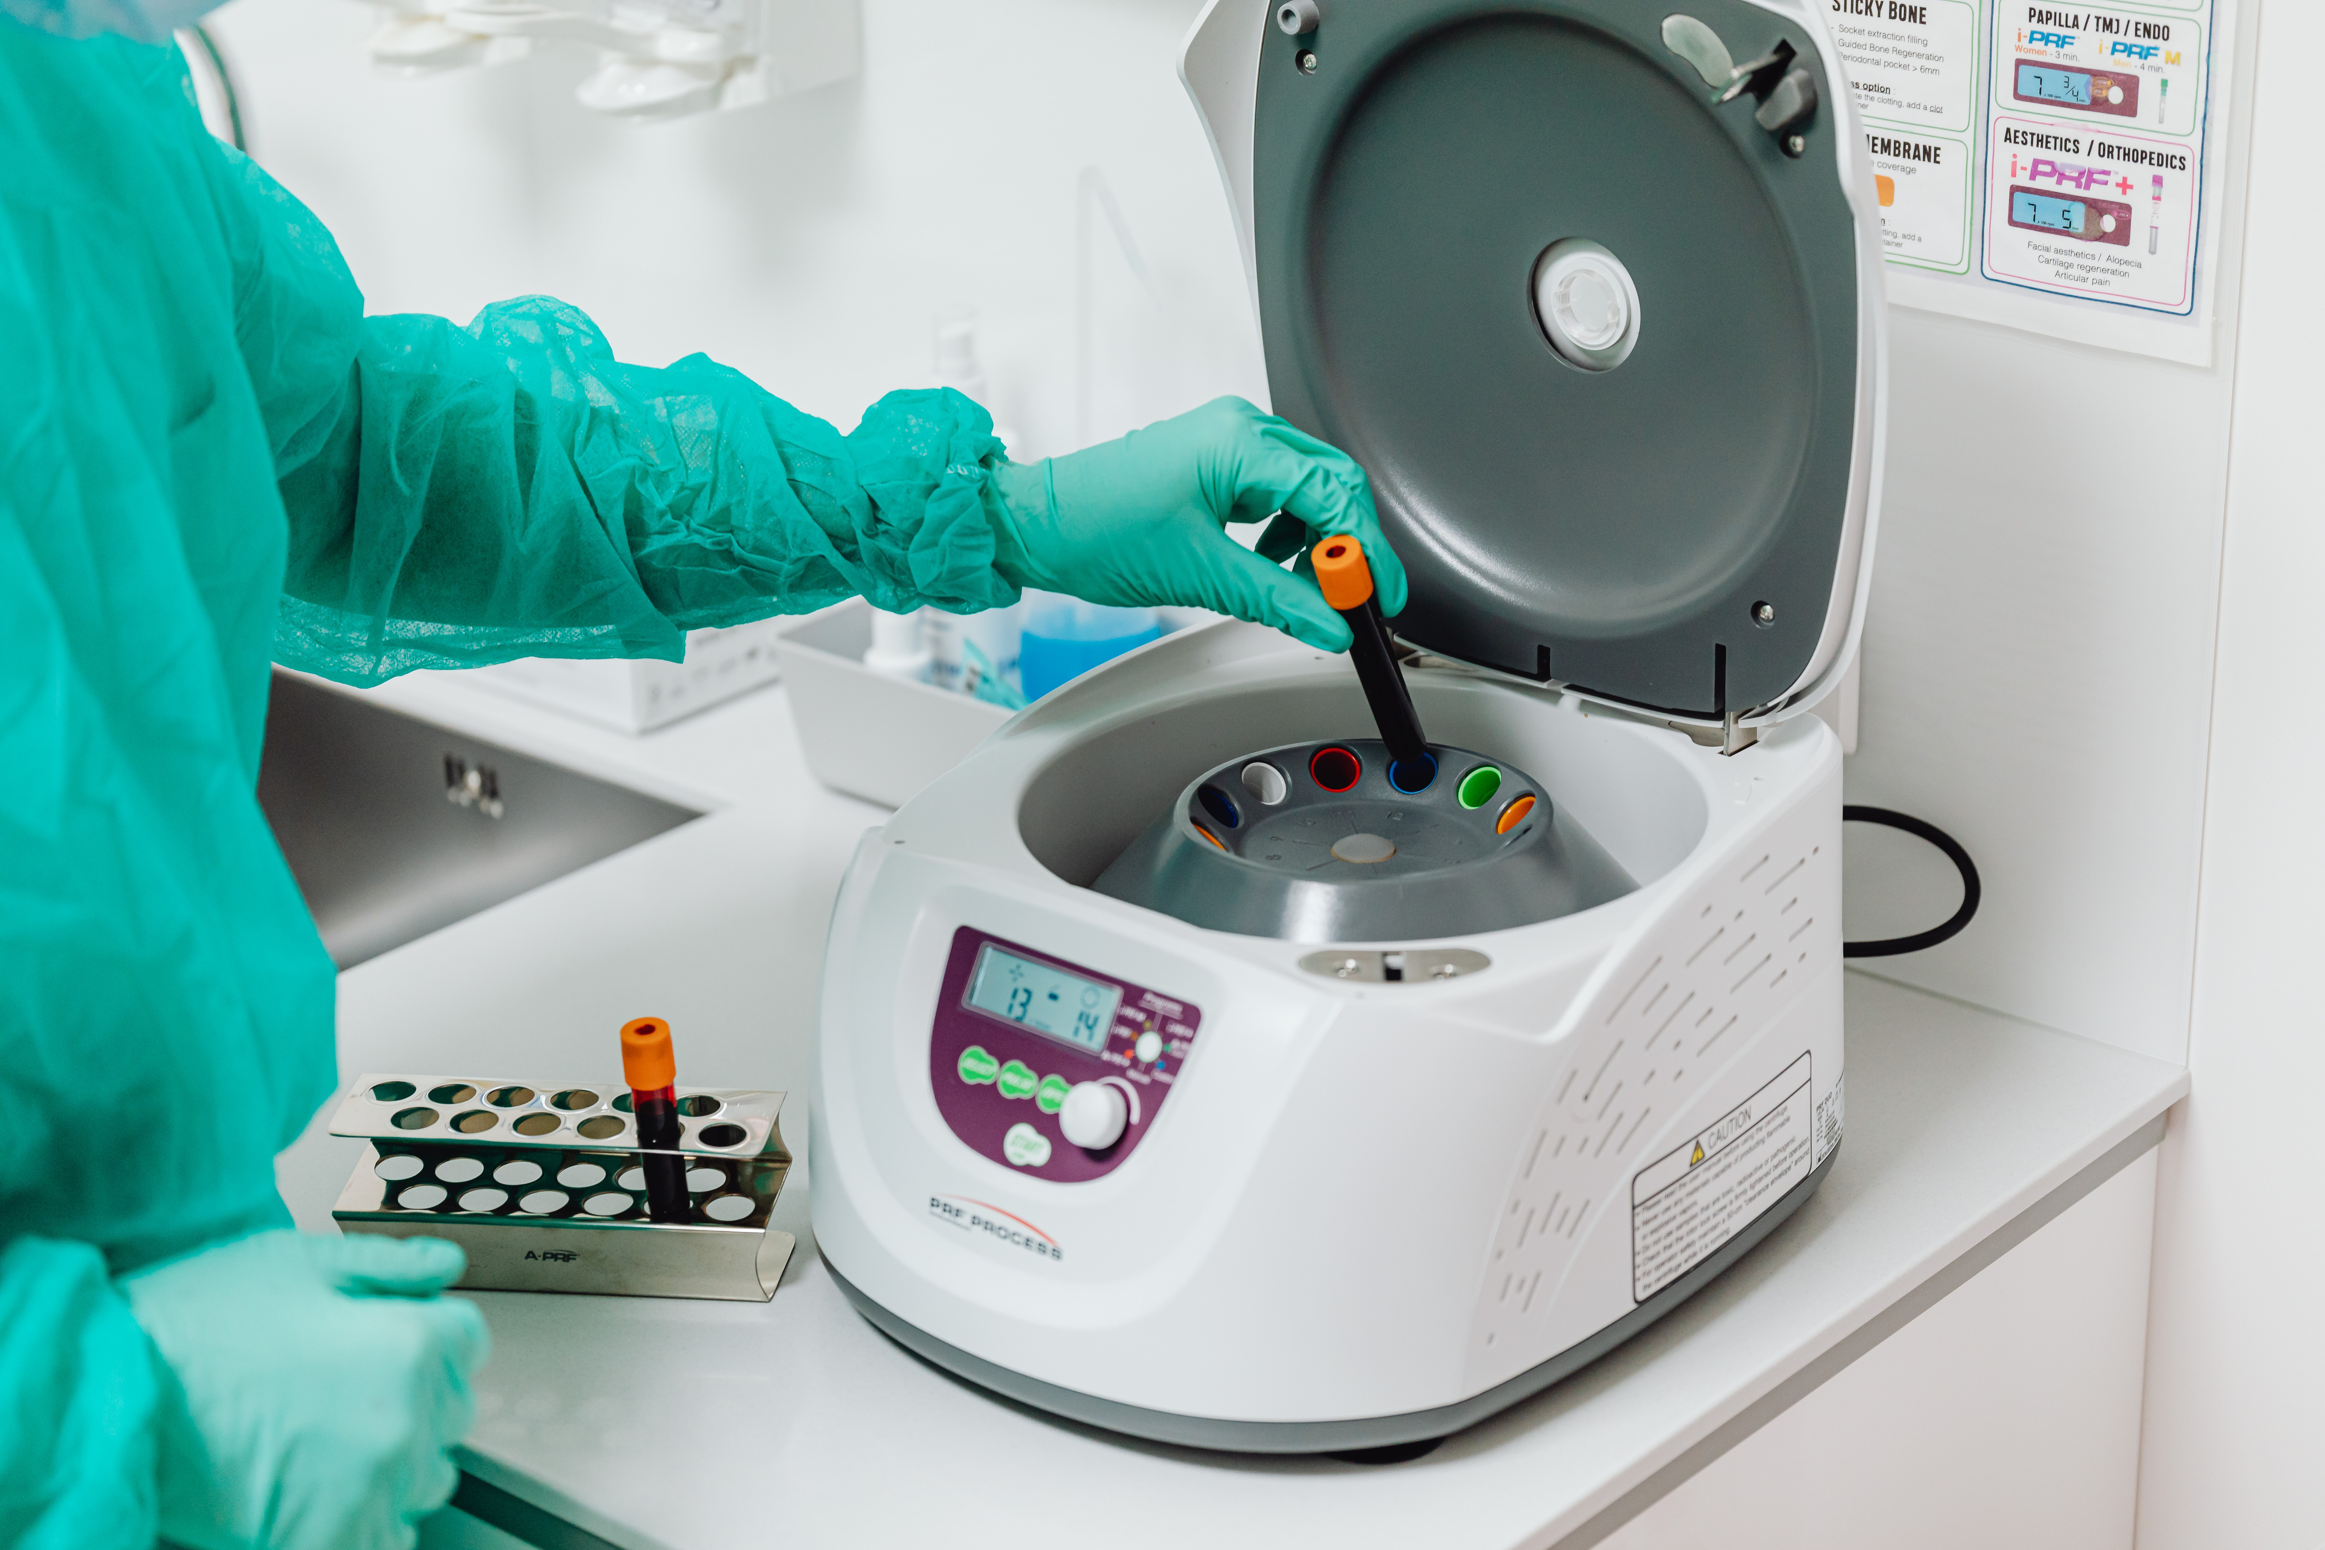
Wardiere Inc.
Biotechnology in Everyday Life
1
Food Productions
Applications You Use Every Day
Utilizing microbial fermentation to enhance the flavor of staples like yogurt, artisanal cheeses, and other probiotic-rich products.
Biotechnology transforms biological processes into practical solutions. Far from being just a lab science, it is a key driver of modern convenience, actively improving our global food supply, advancing life-saving medical treatments, and creating more effective consumer products.
2
Medicines
Revolutionizing healthcare through the development of life-saving vaccines and synthetic insulin.
3
Household Productions
Integrating advanced bio-enzymes into laundry and dish detergents to break down tough stains more efficiently.
4
Agriculture
Engineering resilient high-quality seeds that are more resistant to pests and harsh environmental conditions to ensure food security.

Slide 9

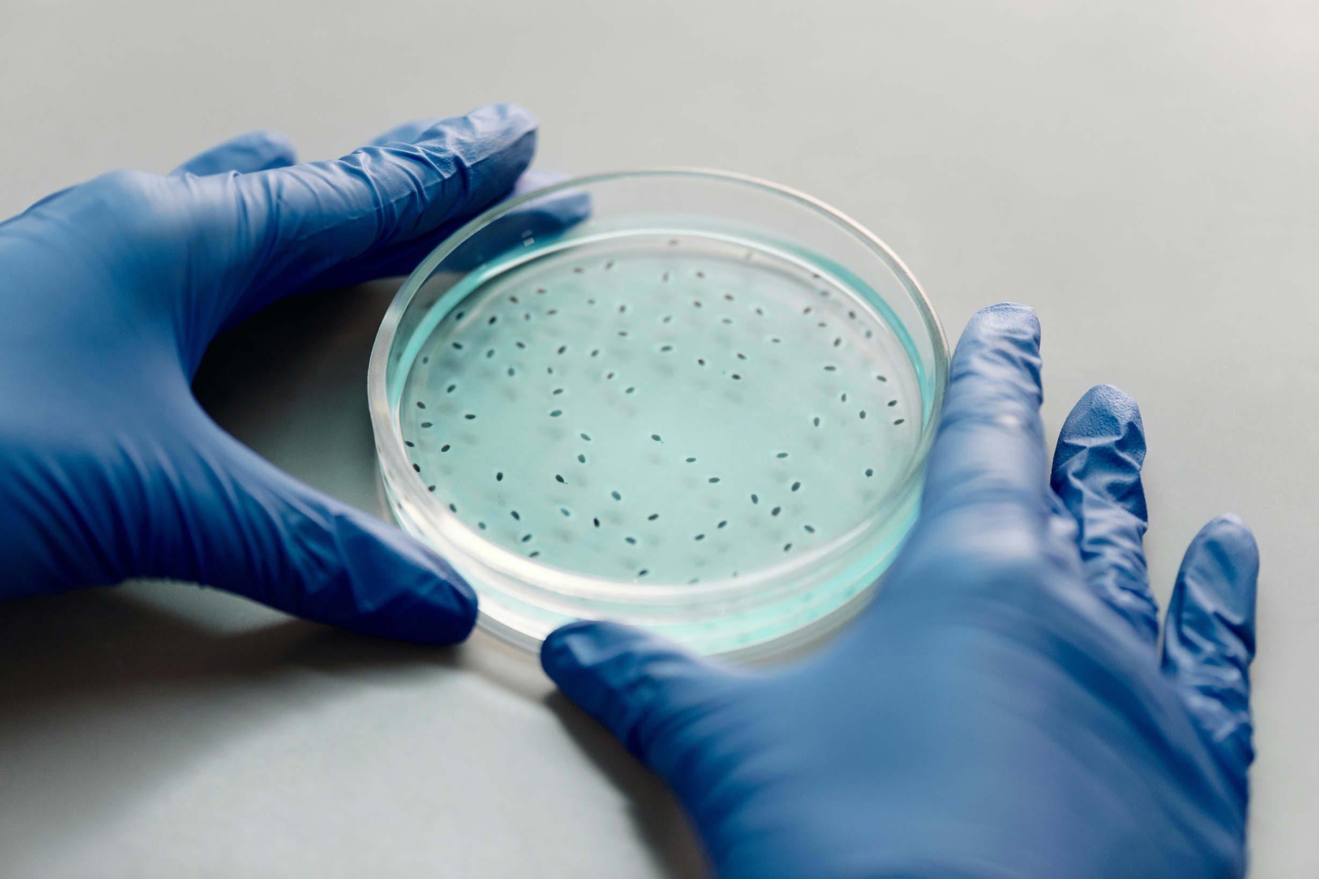
Wardiere Inc.
Importance of Biotechnology
Biotechnology supports global sustainability and innovation across industries by enabling the development of environmentally responsible solutions, improving healthcare outcomes, and enhancing agricultural productivity.
1
3
Health Improvements
Environmental Protection
2
4
Sustainable Agriculture
Economic Growth

Slide 10




Wardiere Inc.
Learn more about biotechnology
By exploring biotechnology further, we can better appreciate its role in creating sustainable solutions and supporting future innovation.
Get in touch
+123-456-7890
www. reallygreatsite.com
hello@reallygreatsite.com

